Slide 1
Springboard data sciences certification program Capstone project
Michael English
Springboard mentor: Goran milovanović, phd
Faculty mentor, torina lewis, phd

Slide 2

Intro to M.e
Michael English
Double Major in Mathematics and Music
Student Researcher
Violinist/Violist

Slide 3

What’s all this about?

Slide 4
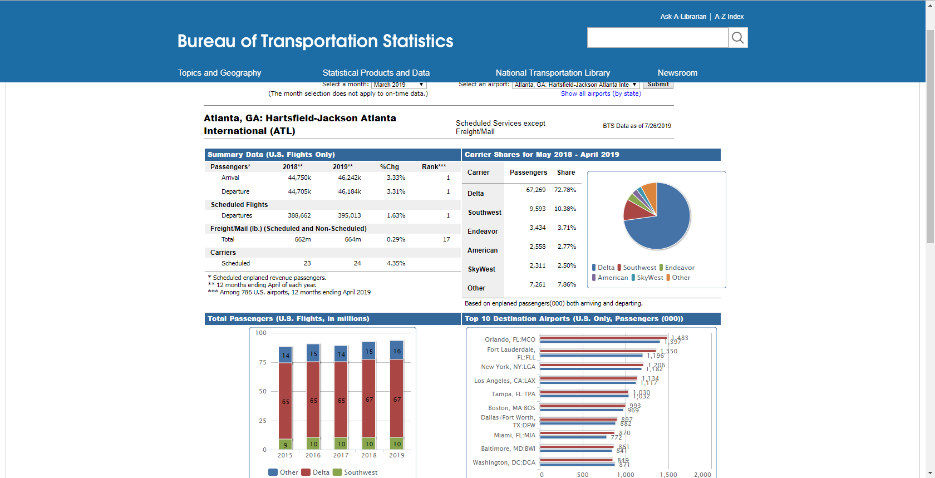
Hartsfield-Jackson International Airport (ATL)
Source: https://www.transtats.bts.gov/airports.asp?pn=1

Slide 5
What is the question?
More consumers utilize air travel than before to fly around the world. Record inbound and outbound flights at Hartsfield-Jackson International Airport (ATL) have lead to ATL consistently being named the world's busiest airport. Since the concentration of people is dense at ATL there is potential to study the social and fiscal trends associated with the steady increasing flow of people through checkpoints. Online resources collect various consumer and aviation data that can be organized to illuminate the notion of using flight routes to determine highly populated times and days at ATL.
This research will utilize various data sets that include passenger throughput, maximum number of passengers per flight, aircraft load data, and popular flight routes from Atlanta to predict the population of passengers in the airport. Results from this research determine when ATL is overcrowded through the comparison of passengers enplaning that are traveling to the six most populous flight routes from Atlanta: Fort Lauderdale, FL; Orlando, FL; Tampa, FL; New York, NY; Los Angeles, CA; and Boston, MA.

Slide 6
How We Do It
Data Wrangling :: Cleaning and Organizing Data for Efficient Use
Exploratory Data Analysis :: After Cleaning, a comprehensive analysis of the data and structure
Statistical Analysis and Data Visualization :: Visual charts, plots, and graphs which allow for statistical inference.
Machine Learning :: Applying regression models to datasets to determine actively “predict” what is happening, mathematically

Slide 7
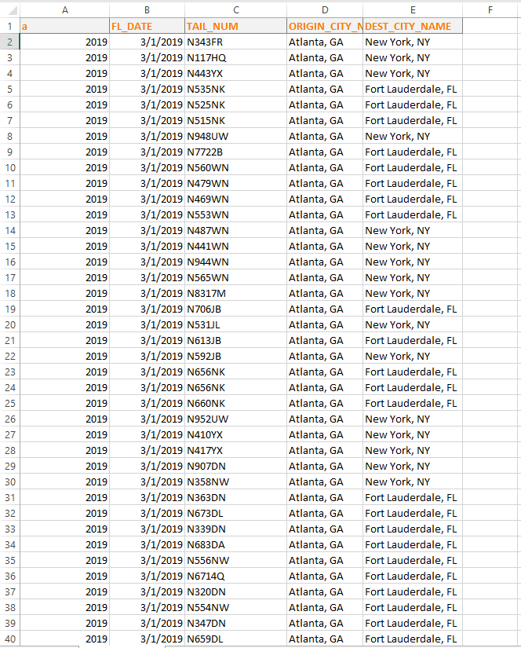
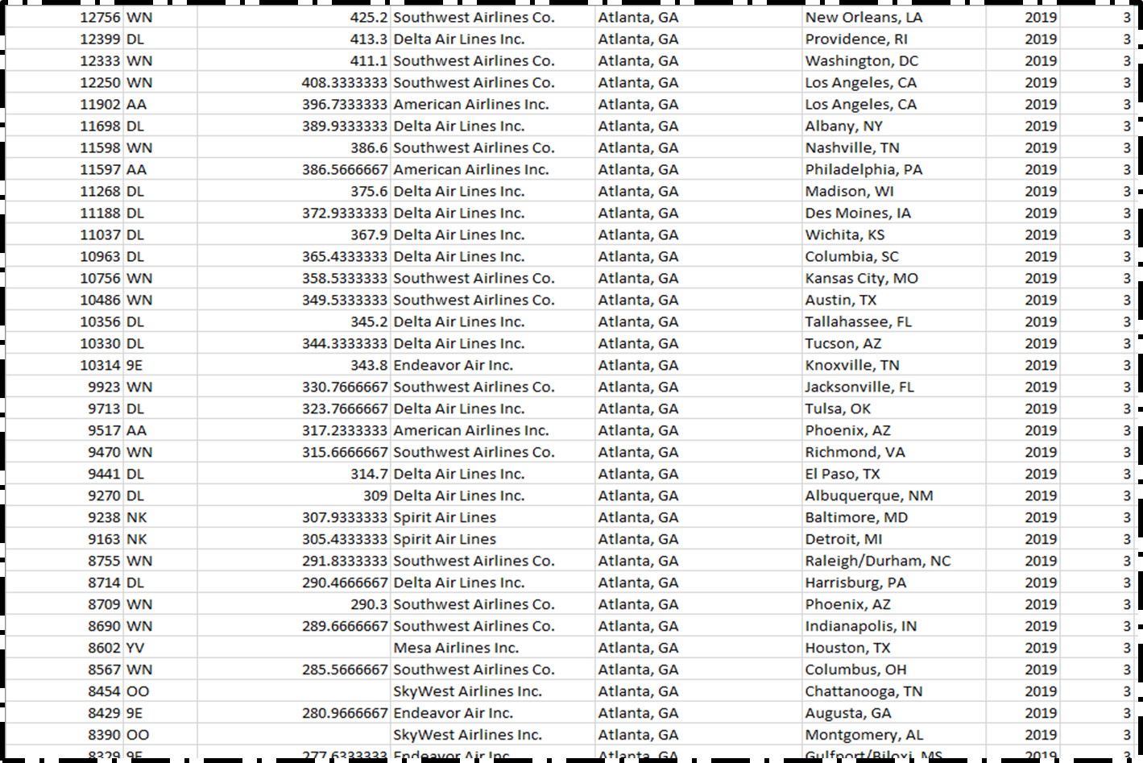
The DataSets
To develop a model for predicting the population at Hartsfield-Jackson Airport (ATL) on a particular day, specific information is retrieved and merged from a list of publicly available databases.
Atlanta Routes Database [1]: In this database, the total number of passengers that enplaned in ATL in March 2019 are listed.
BTS Database [2]: This database provides information regarding all flights enplaning at ATL for the month of March in 2019.
[1]
[2]

Slide 8
Data Wrangling
Cleanliness may be defined to be the emblem of purity of mind.
- Joseph Addison
Used Data Wrangling to clean the databases; Figures 1 and 2 shows the Atlanta Routes database before Data Wrangling, some columns are not of use and removed.

Slide 9
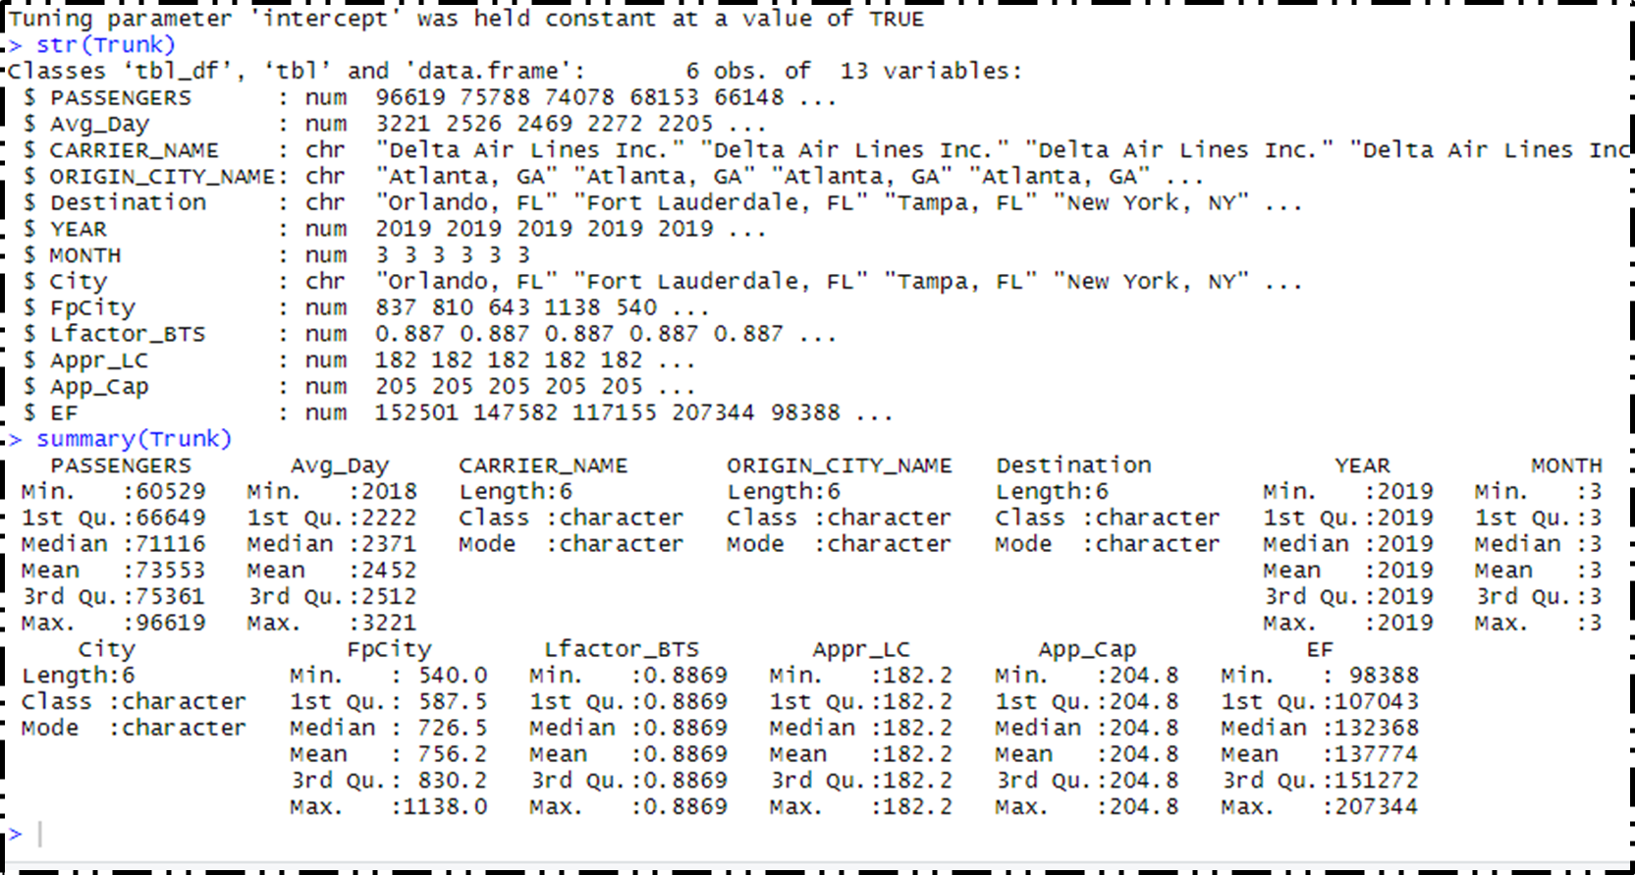

Data Wrangling
Looking at the structure (str) of Trunk, we see that there are an array of columns removed and added before consolidation:
YEAR and ORIGIN_CITY_NAME were variables available in both datasets, and thus redundant. The extra set of rows were removed.
Developed a sub-dataset that refines the collection to 6 points, collective, based on the six cities. The load factors of aircraft, averages based on the flights to the six
After cleaning and organizing the two datasets BTS and Atlanta_Routes, the next step was to consolidate them into a more efficient and useful dataset, denoted Trunk.

Slide 10
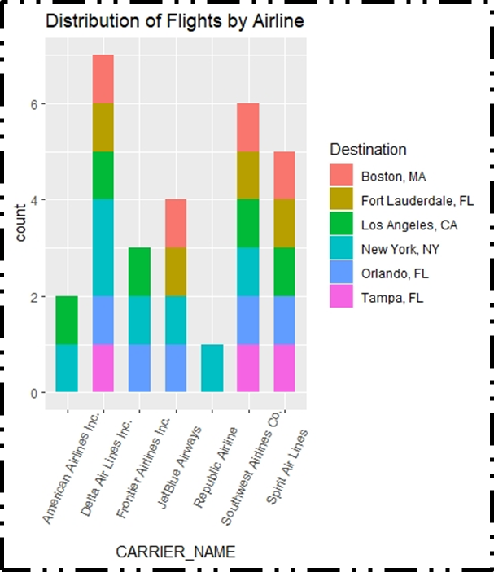
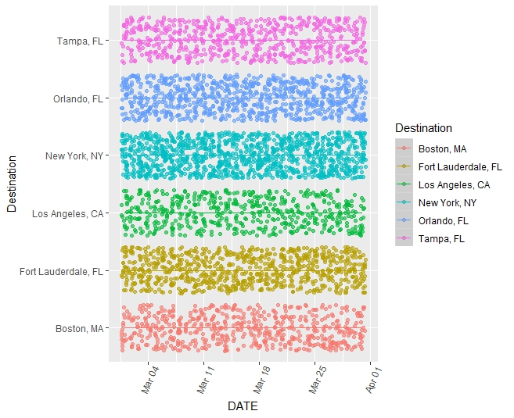
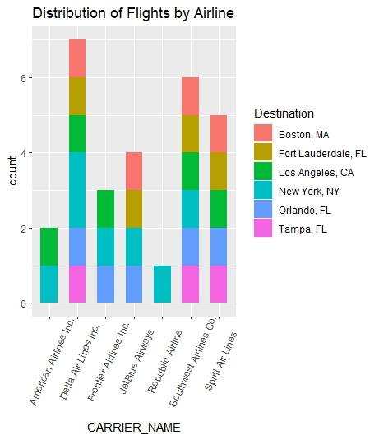
Statistical Analysis
In Figure 3, each dot on the scatter plot represents a flight from the BTS database. passenger population at the airport:
Figure 4 represents the breakdown of flights, Southwest Airlines provide a balanced baseline from having the most flights to these major cities. Further, HJ_ATL is the home hub for Delta and Southwest, making them great data banks for enplaning flights.

Slide 11
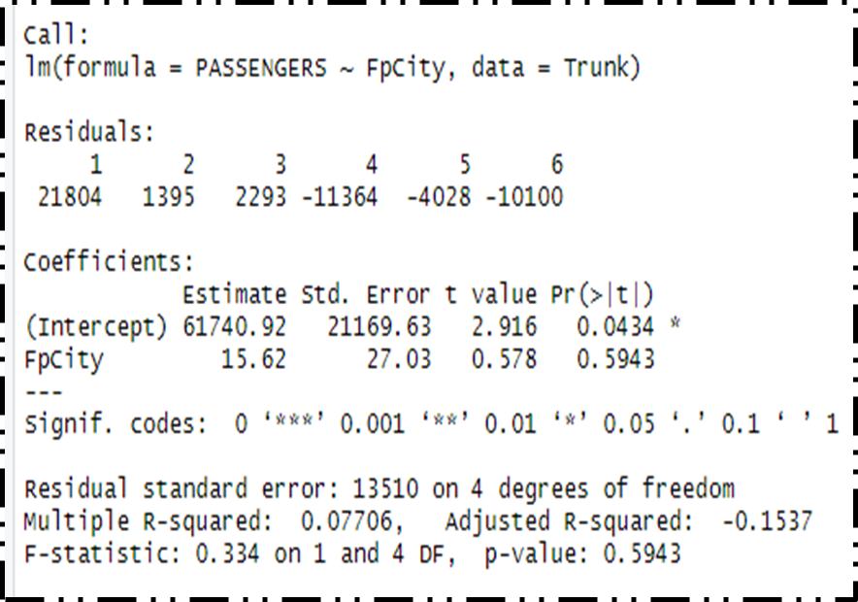
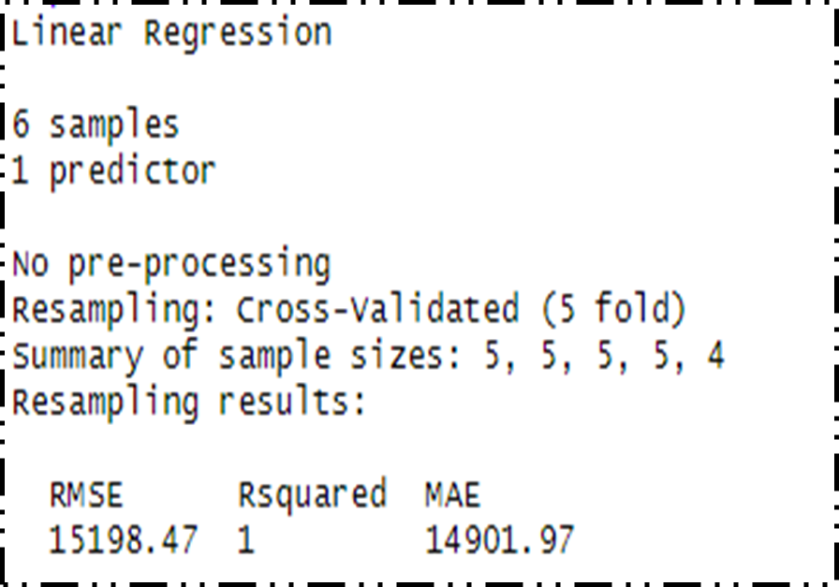


Machine Learning
Figure 5: This figure includes the code for the linear regression model on the training data set. The training data set contains 80% of data in the original data. The dependent variable is PASSENGERS, and FpCity (Flights per City) is the independent variable. The value of $R^{2}$ is .08, which is a less-than-desirable result, the data points deviate from the regression line.
Figure 6: Using cross-validation, R executes the code five times using a random sample from the training data set. The best result will be populated as the best option for regression model. The value of $R^{2}$ is 1. This means that using cross-validation, the points lie on or very close to the proposed regression line.

Slide 12

The analysis.
Interpreting R-squared: A value that is closer to 1 means that the model is better at predicting the data behavior. Here the R-squared value is 0.08; this value is far from 1. Thus a more efficient model that gives better approximates are available. The value of the cross-validation model is 1. This value also provides concern.
The best-fit equation that represents the linear progression is approximately:
Passengers $=15.62x+61740.92$
The Root Mean Square Error (RMSE) is the value that represents the standard deviation of the residuals. That is, the average distance that values are from the prediction line. A higher RMSE means that points are farther away from the prediction line. In the cross-validation, the RMSE is observed to be very large. Thus the points are deviating drastically each other but are following closely to the regression line with R² value of 1.

Slide 13
Future work
In the future, the linear regression model will be expanded to consider additional independent variables. This change can improve the significance of the variables and may lead to a higher R-squared value and thus a better prediction. Also, the expansion of the data points will allow for a more detailed analysis.

Slide 14
Acknowledgements
I would like to acknowledge my Springboard mentor, Dr. Goran Milonavanović, my faculty mentor, Dr. Torina Lewis for their expressed support, and the HBCU-UP Implementation Program.
This research opportunity was sponsored by the National Science Foundation, award numbers 1700408 and 1818682.

